Slide 1

EasyPark
Name: Swetha Venkatachari Sundarajan
Email: vswetha@pdx.edu
License: MIT License (MIT)

Slide 2
Targeted Audience
For any one who wants to find a vacant parking spot and park the vehicle
Description
EasyPark app enables users to find free or paid parking spots near their location
The users can block the parking spot and receive a notification when the parking ticket is about to expire
Users can also get directions from their current location to the parking lot

Slide 3
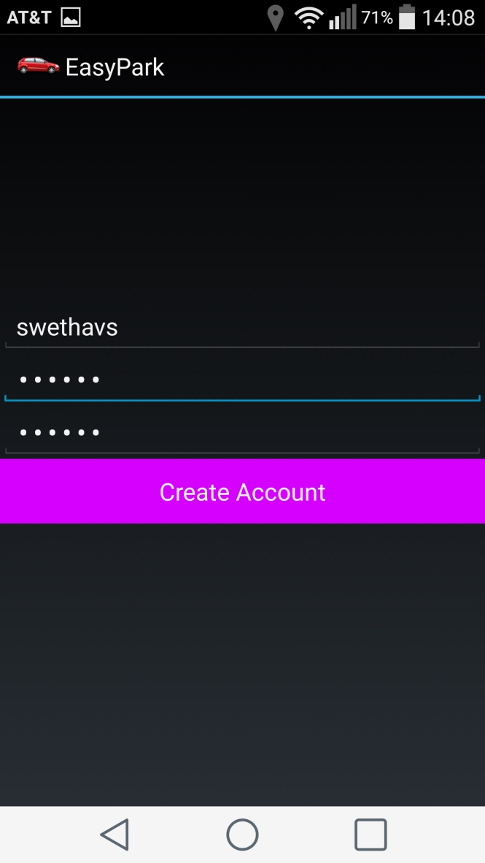
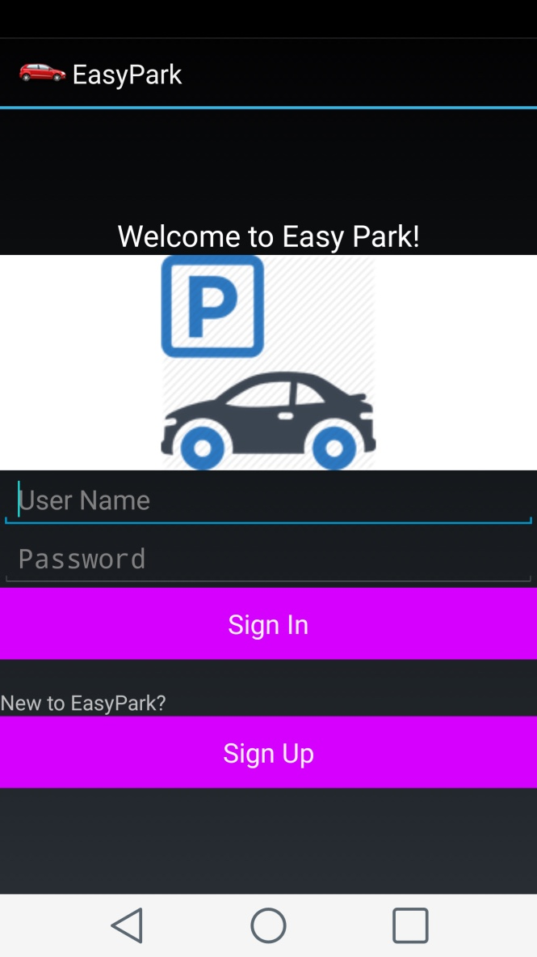
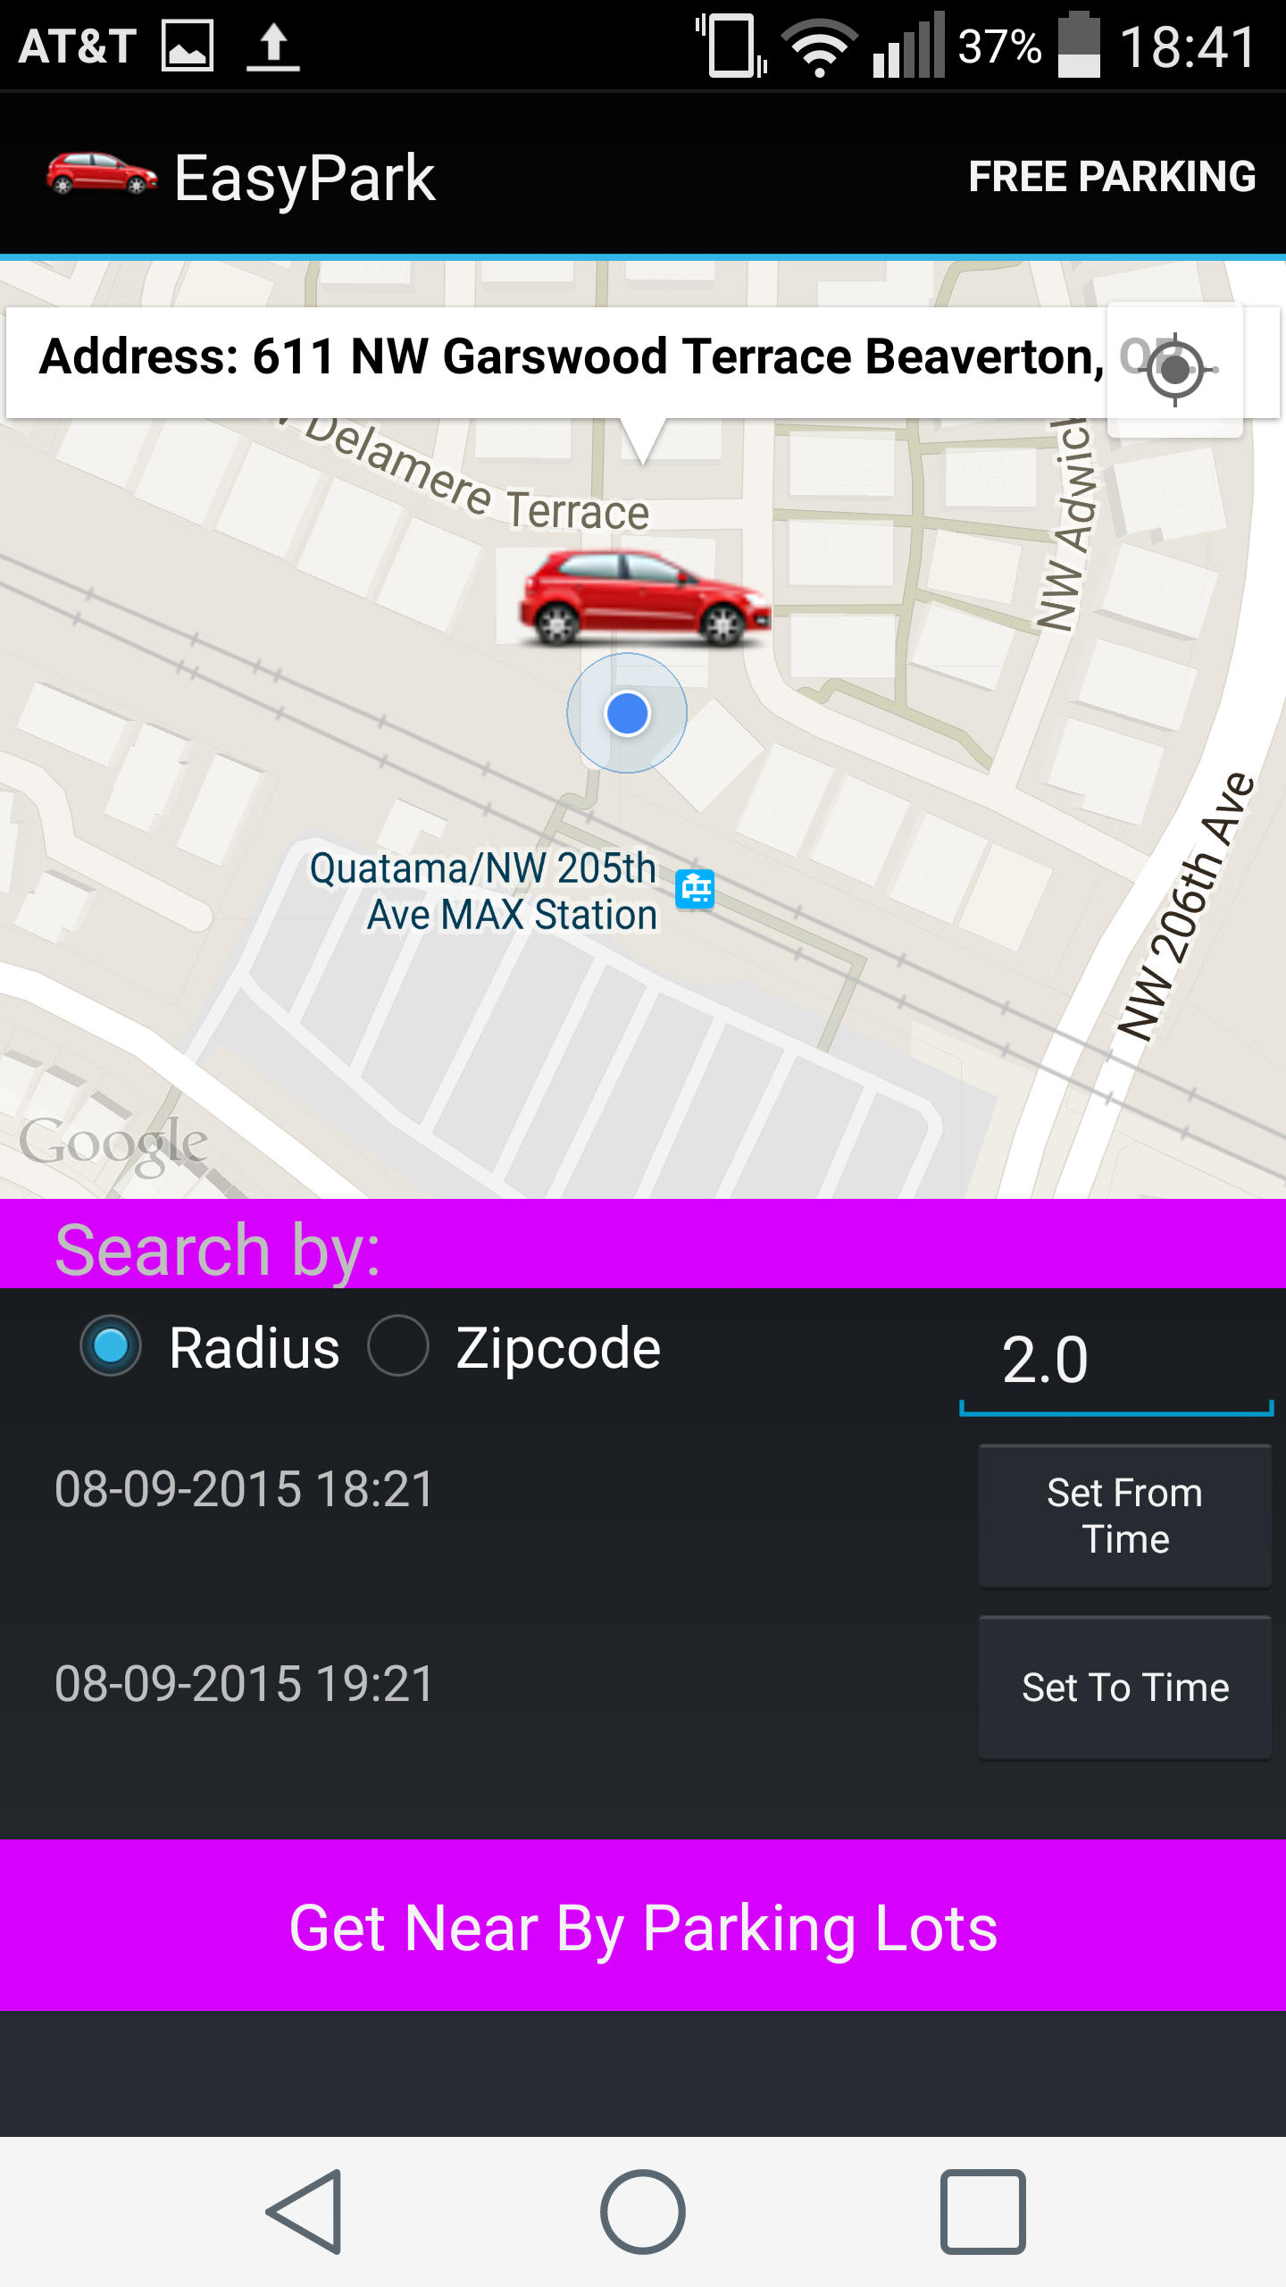
Login Screen

Slide 4
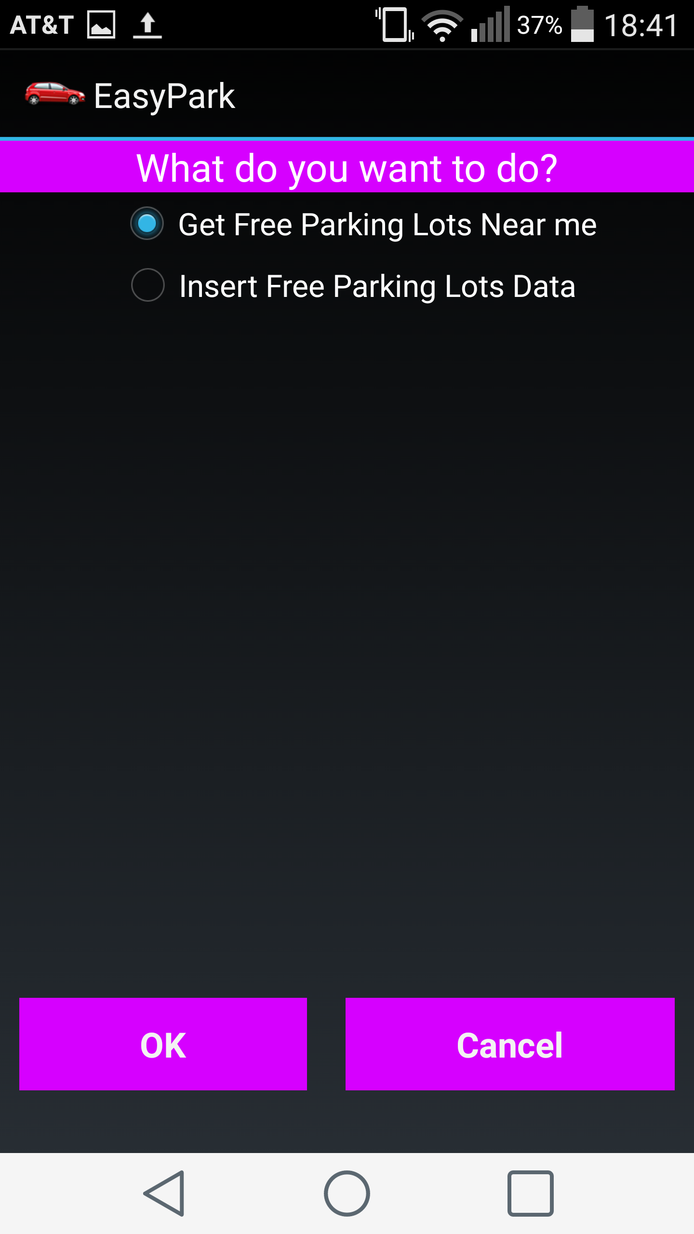
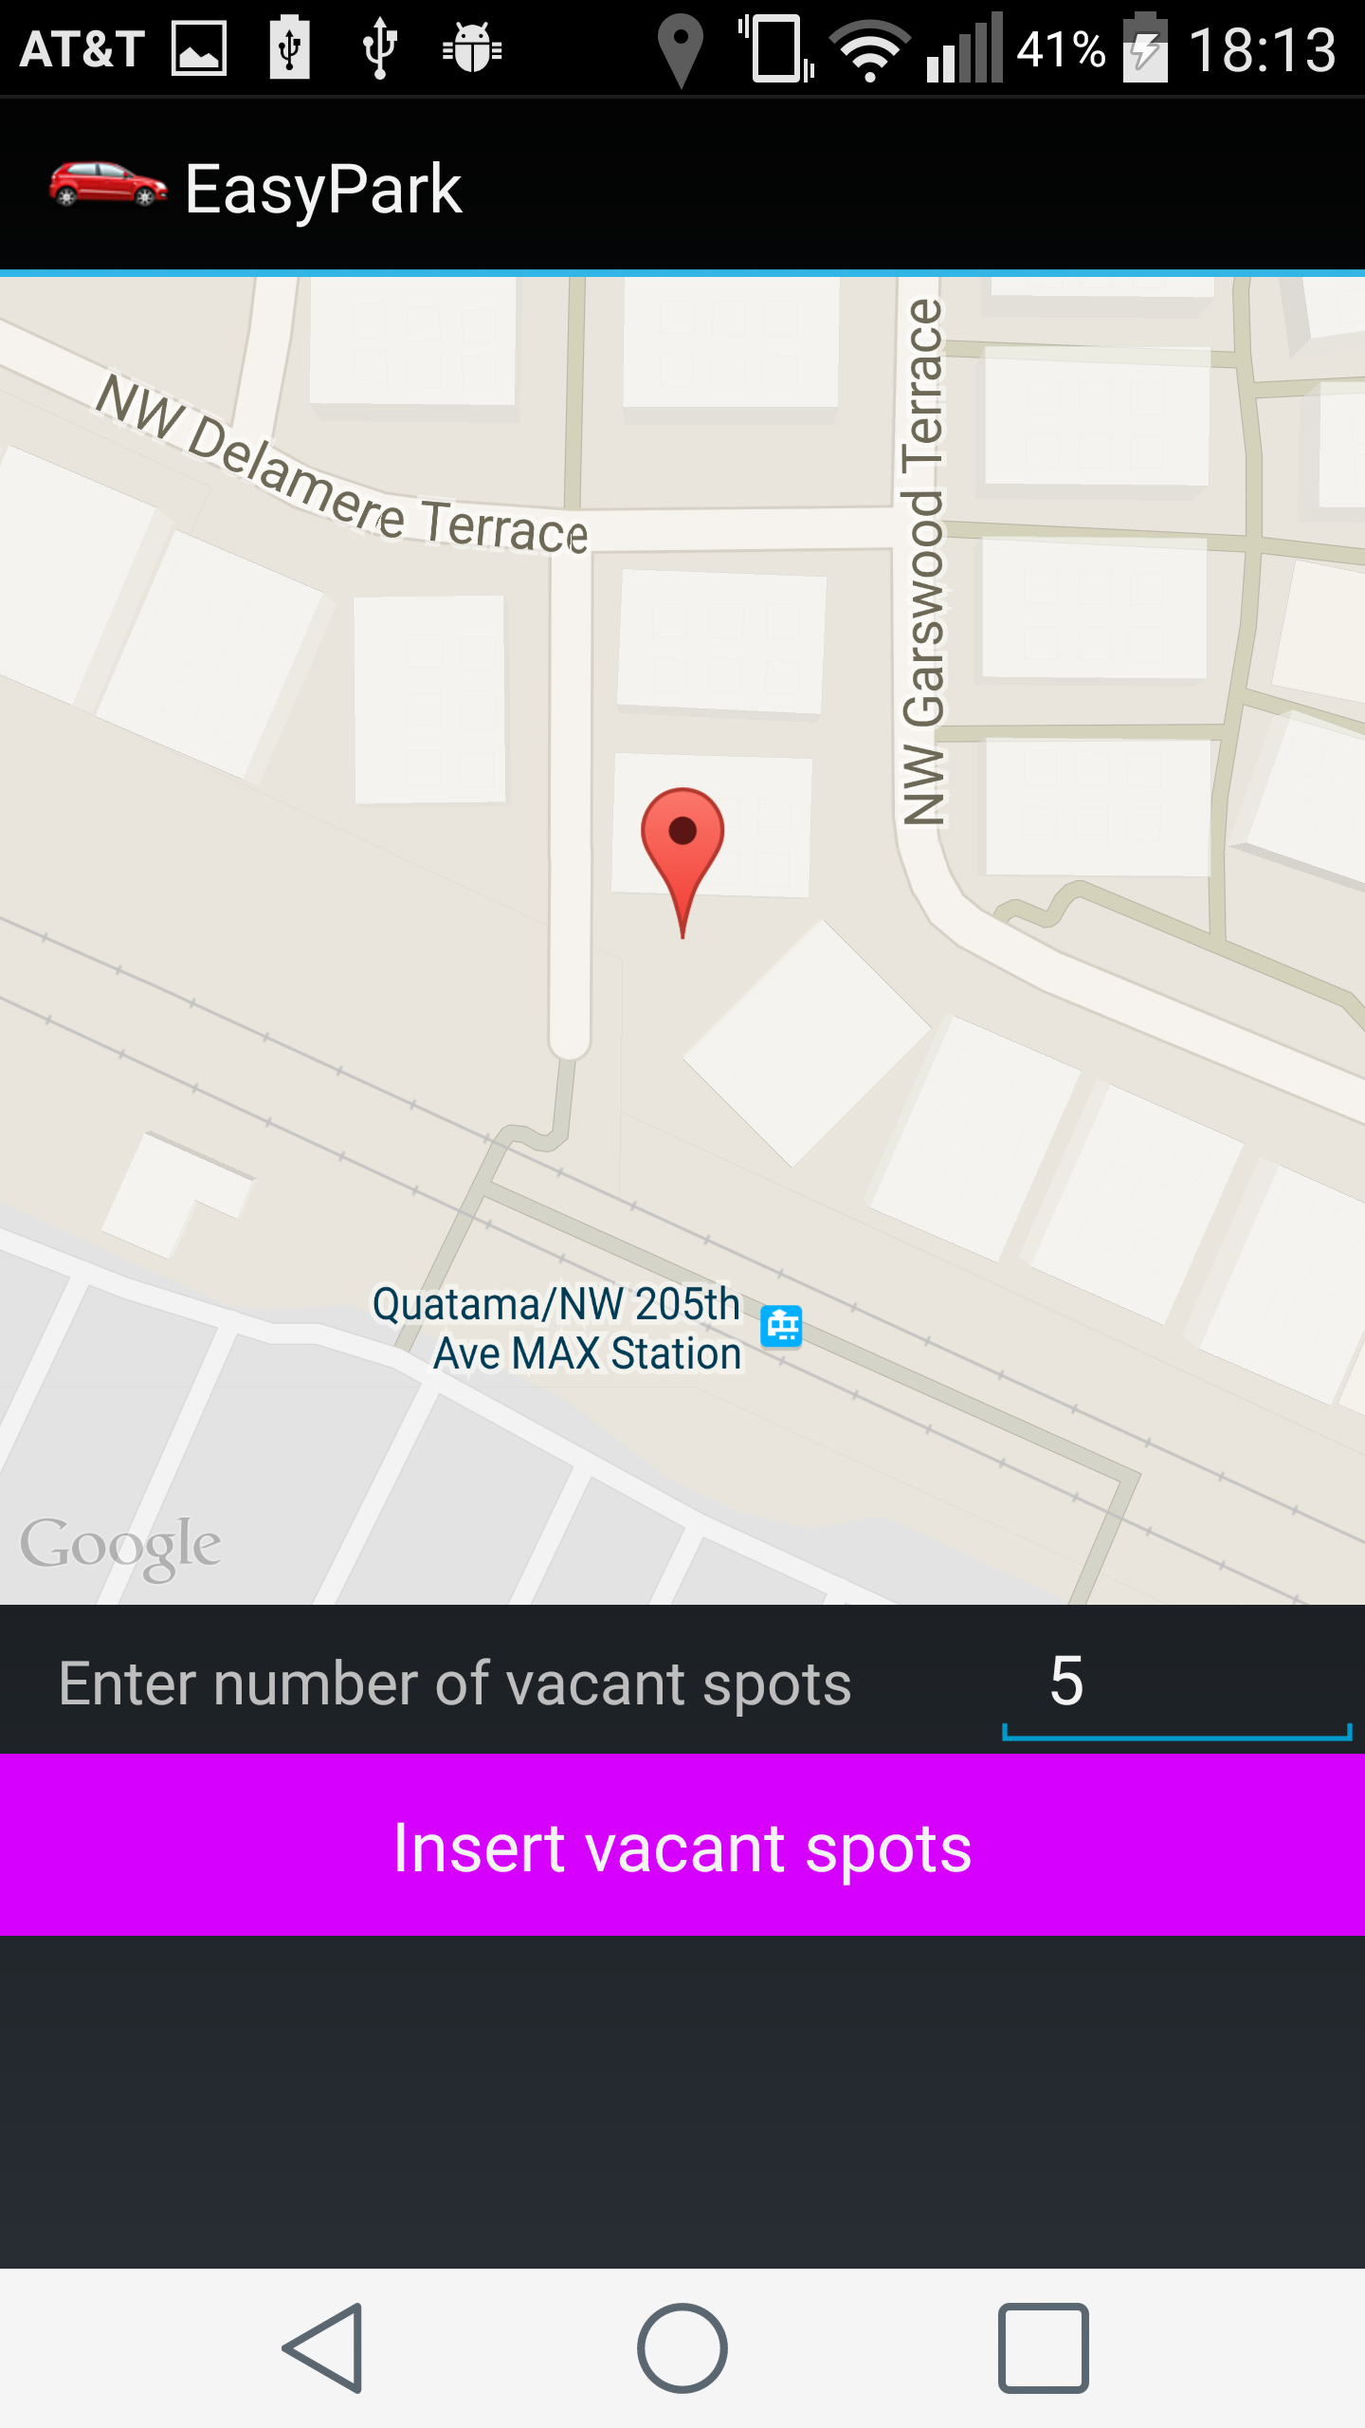
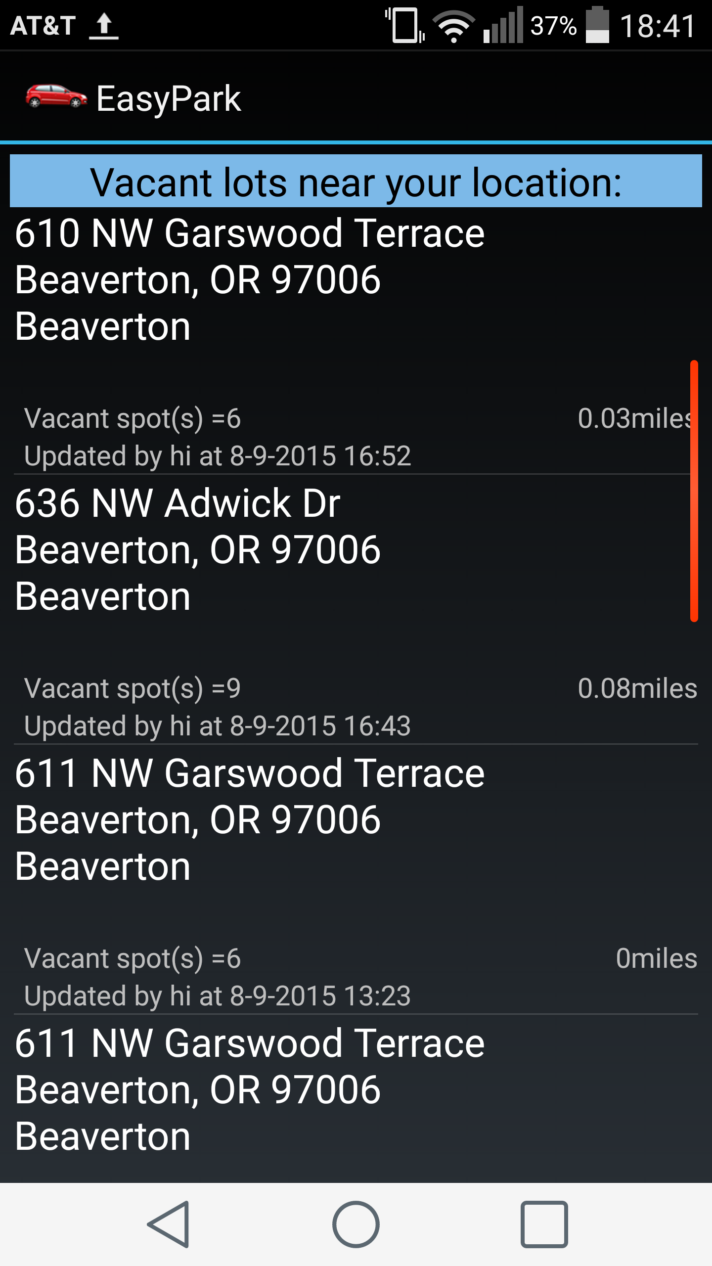
Free parking

Slide 5
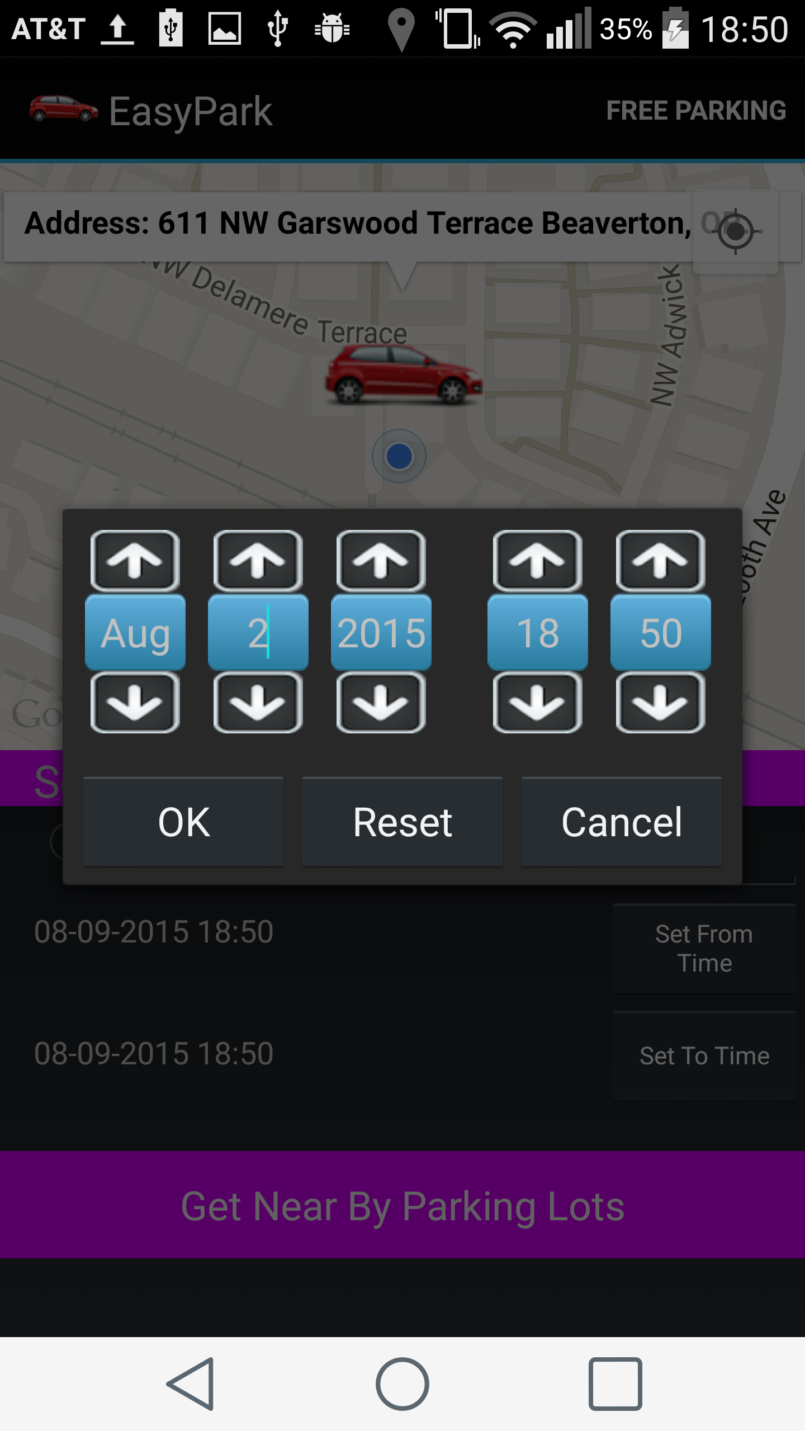
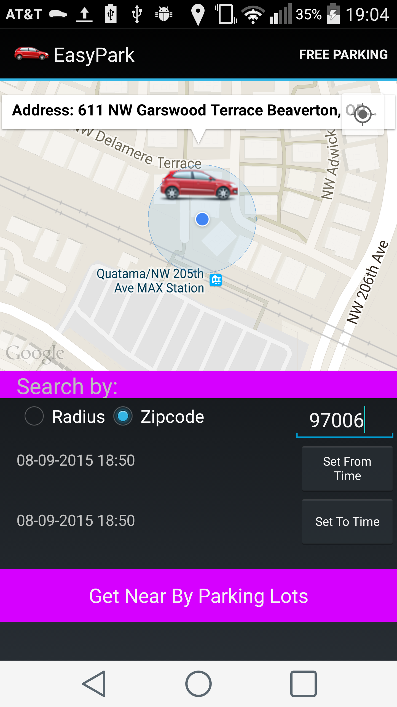
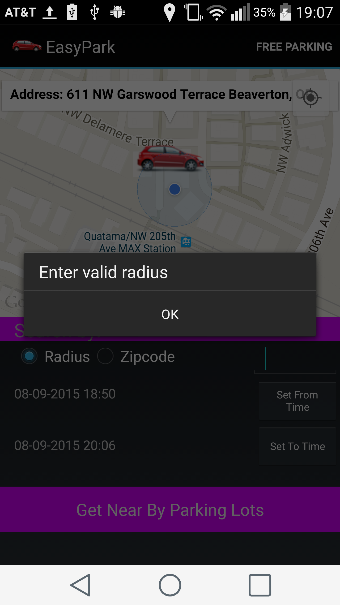
Paid Parking

Slide 6
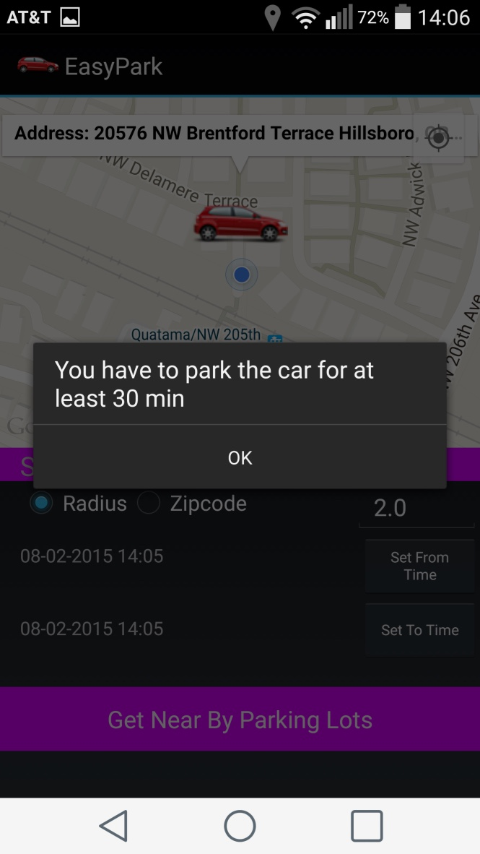
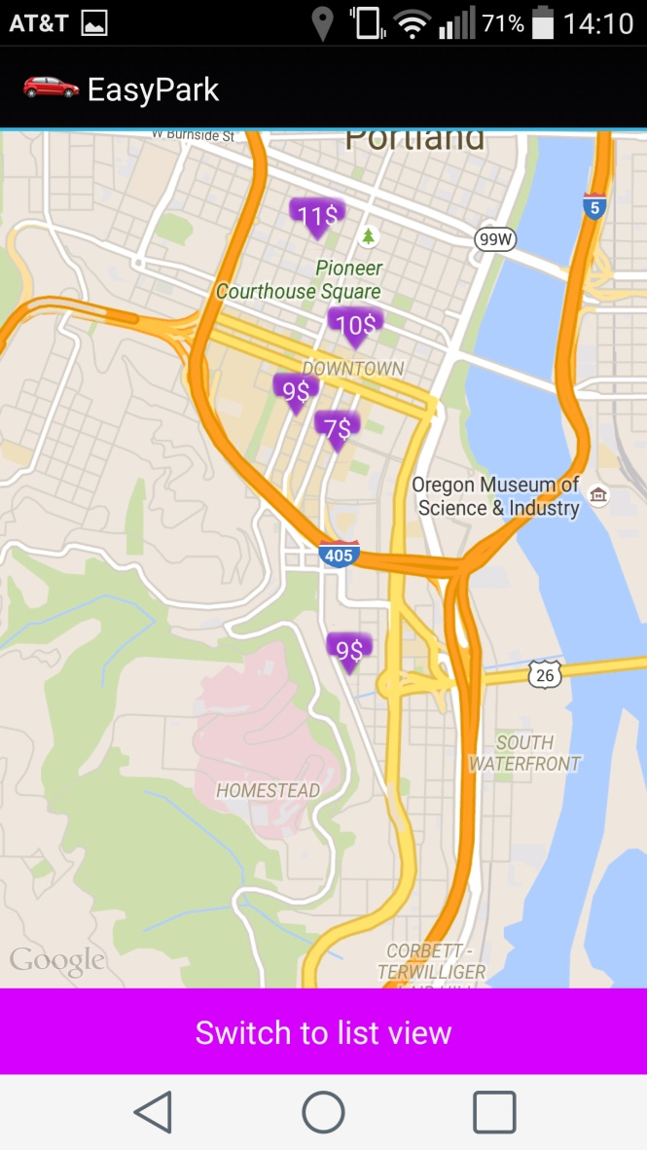
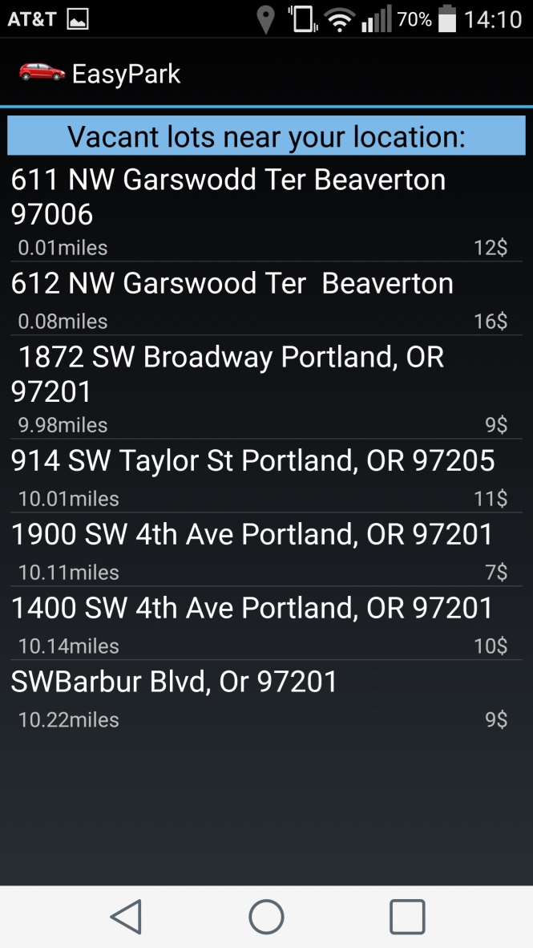
Vacant Lots

Slide 7
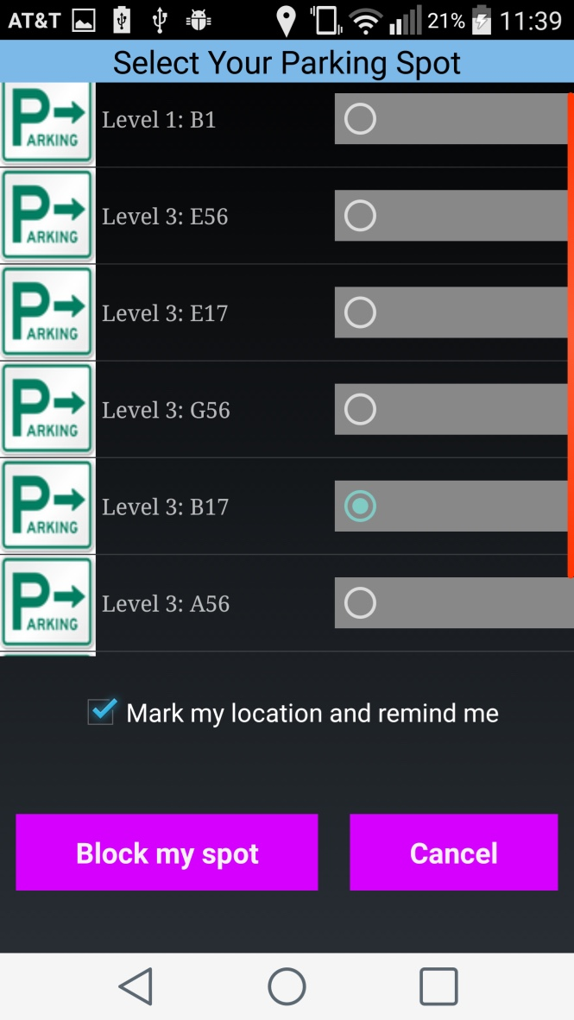
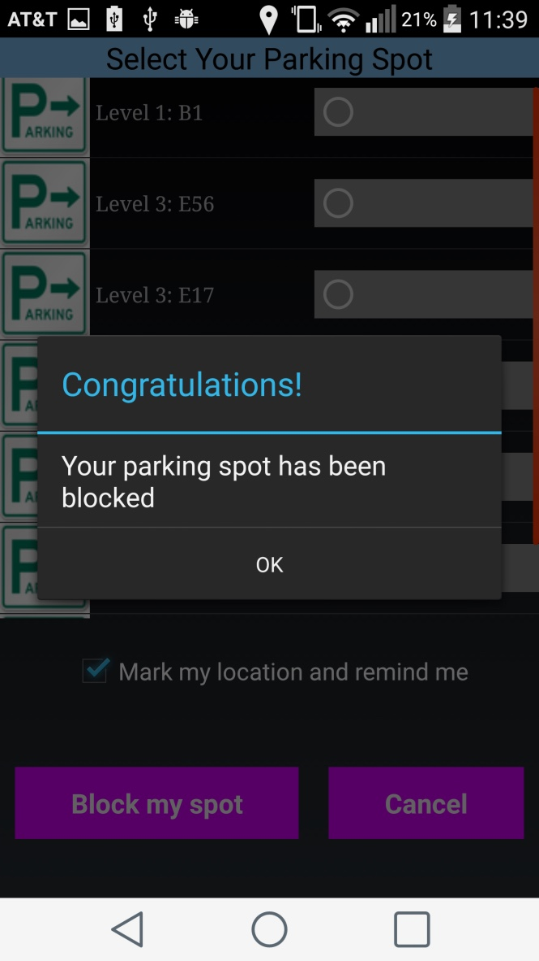
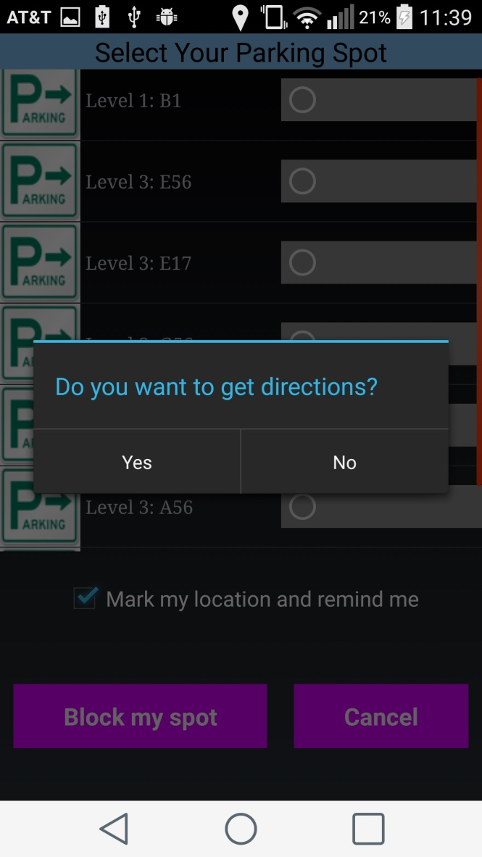
Block the Spot

Slide 8
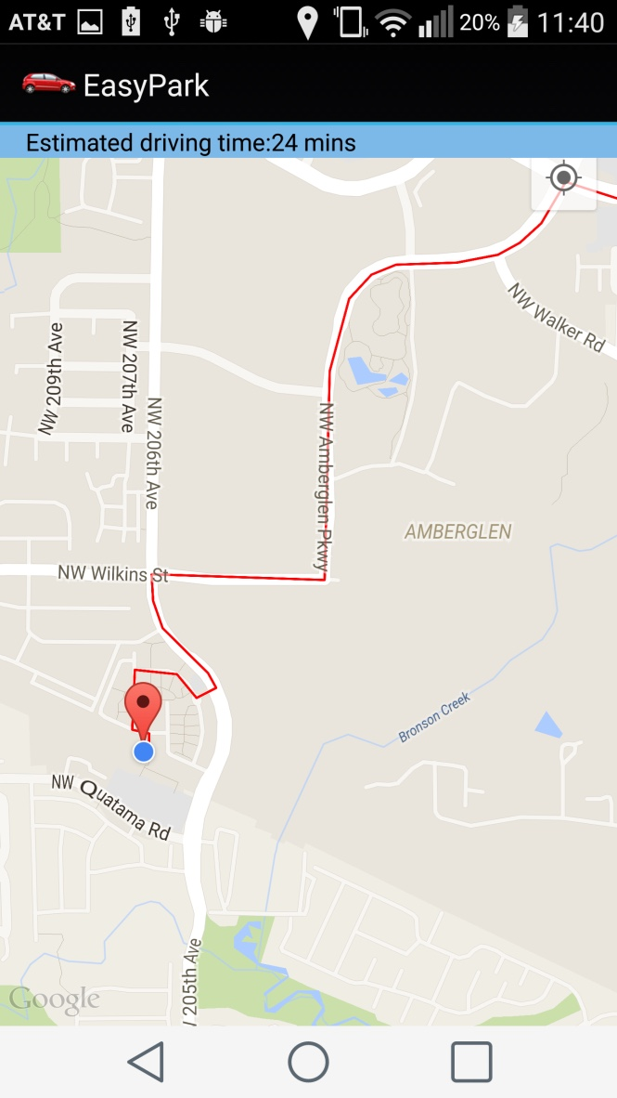
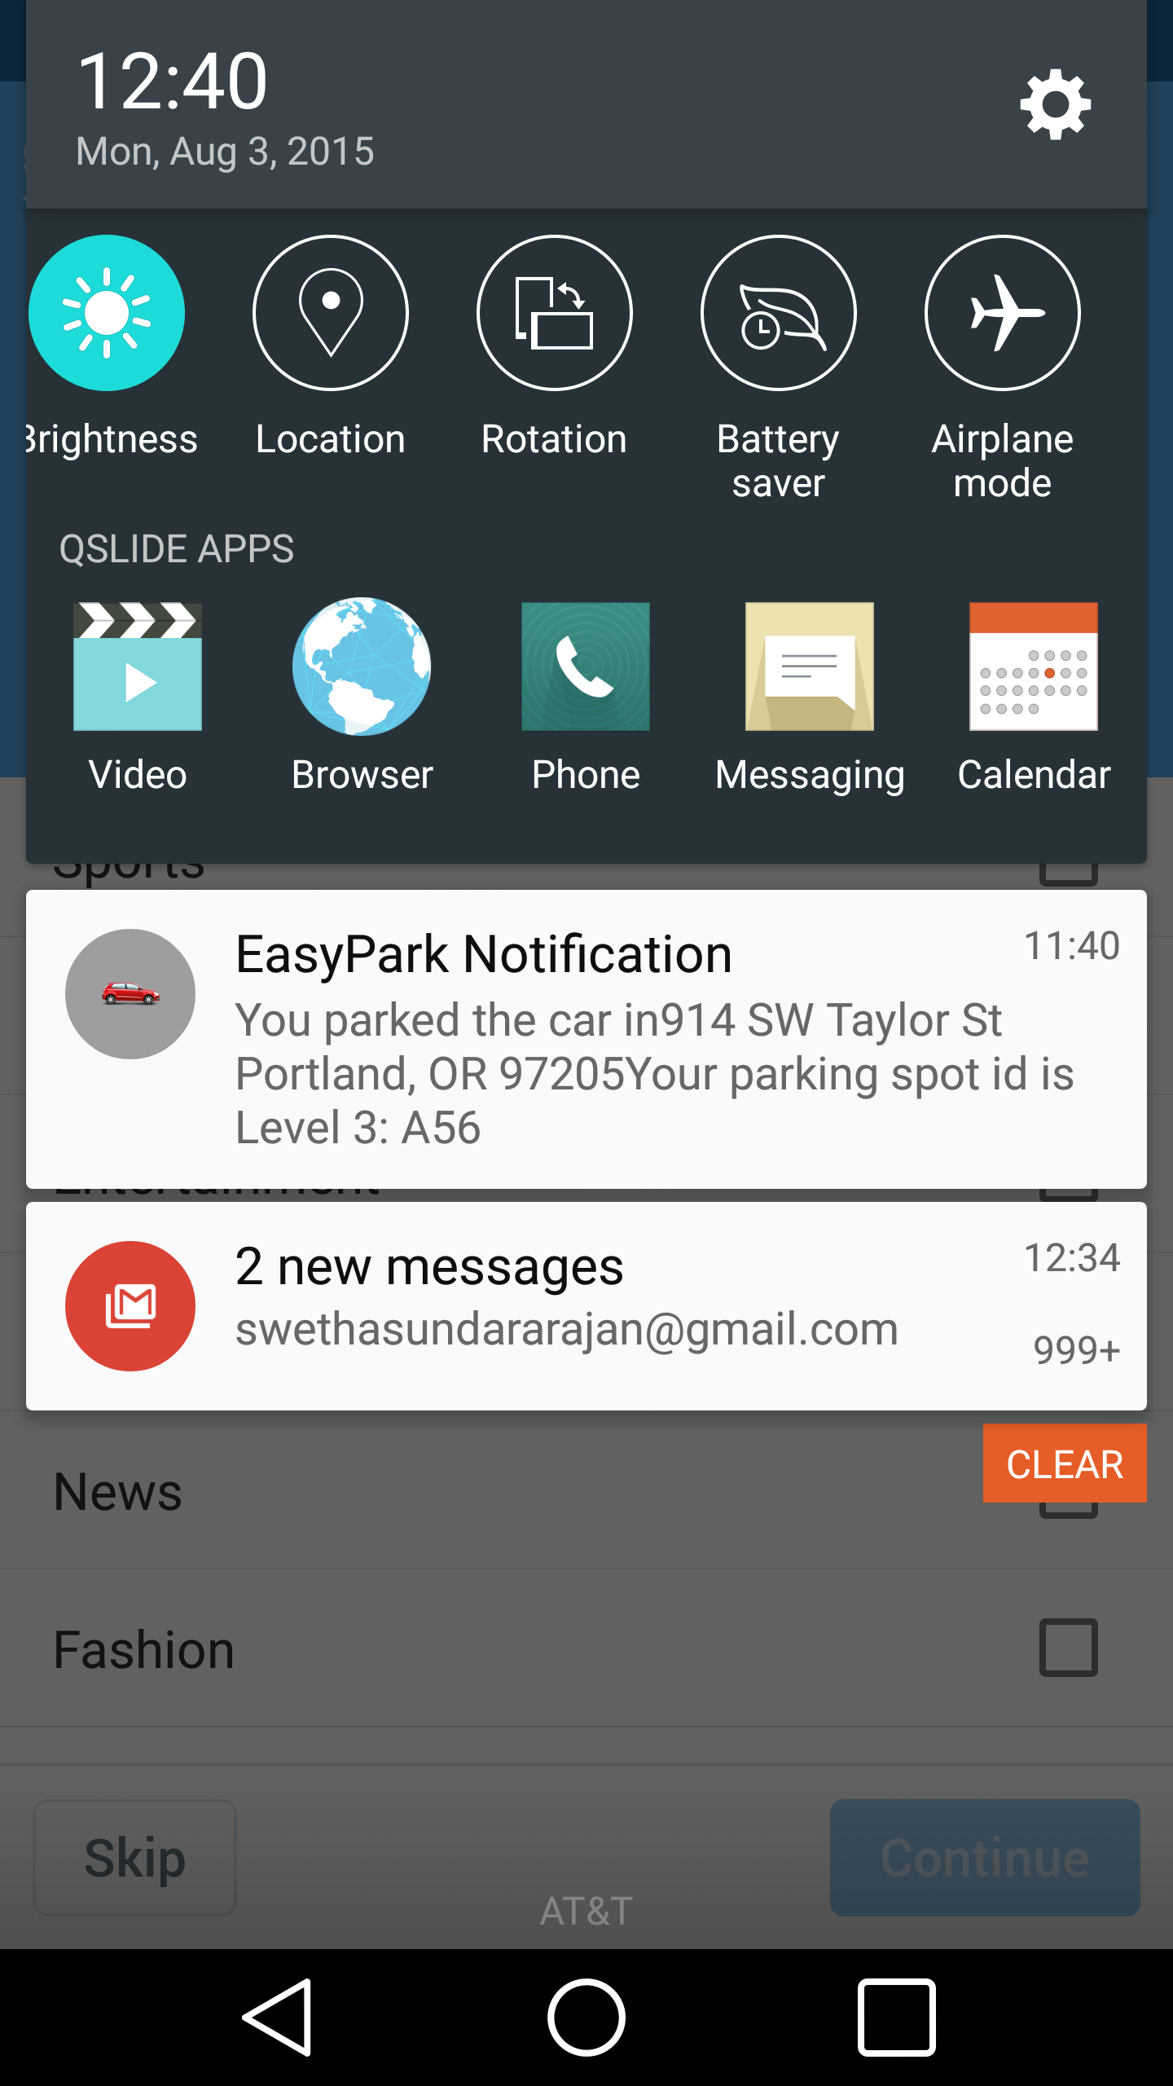
Direction and Notification

Slide 9
Technical details
This is an android app developed with API target 22 (5.1.1) Lollipop and tested in Lollipop (API 21, 5.0.1)
It uses Web API developed in PHP/MySQL in the backend to store and retrieve parking data. The WebAPI is hosted in http://www.000webhost.com/.
Website name: http://easypark.net46.net/easypark/
3. SQLite for storing the Login related info(username and password)

Slide 10
Advantages
Doesn’t involve deployment of sensors to track the vacant parking spots, thereby cutting cost
Enables users to park the vehicle hassle free
Avoid traffic congestion
Helps users in finding cost-efficient and nearest parking spot anywhere they go
Reminds user about 10min before parking time expires

Slide 11
Future Enhancements
Add verification number or QR code after user blocks the parking spot
Get real time parking data for paid parking
Integrate with a pay service
Introduce reward points to increase the number of customers

Slide 12
Something to share
Was thinking that there are built-in methods in android to add radio button in list view dynamically.
Had to create a custom list view and a class to hold the currently selected item in the list view and change the currently selected item every time
Google allows only 1000 hits per day to get the location data. You can increase the limit to 150,000 hits if you enter the billing information

Slide 13
Other Options
We have apps like ParkMe, Car2Go by Google and ParkWhiz but they cover only few cities
Manually look for the parking spots and park the vehicle

Slide 14
Thank You!
Queries?

